Slide 1




Satellite Design & Integration
Build Session 2
Power integration and telemetry
Notes:
Day 3, Thursday 15 October. 15:15-17:00, 1 h 45. Follows Lecture 2, Power and thermal.

Slide 2
Build Session 2 — Power integration and telemetry
Side panels and solar panels
Notes:
Mounting the power-generating faces. No code.

Slide 3
Satellite Set-up -Side Panel

Slide 4
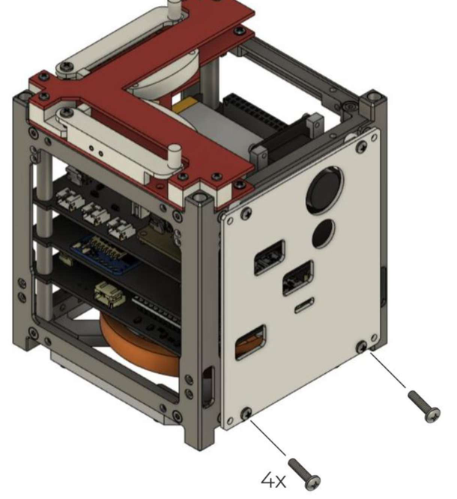
Satellite Set-up -Side Panel
To correctly place the panel, we are
going to need back spacers!
After placing the side panel, take some kapton and label EPS, ADCS, RBF and OBC with a marker.

Slide 5
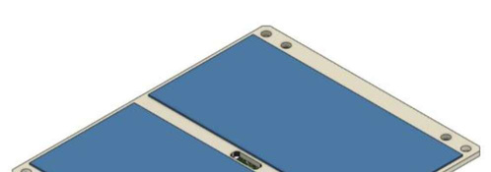

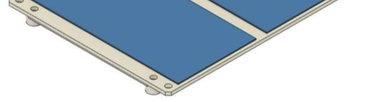
Satellite Set-up -Solar Panels
Solar panel cells are extremely fragile and tend to be broken easily if touched.
Avoid touching them directly with your fingers.
Be careful not to hit them with tools.
Most importantly, do not place the faces with solar panels directly on the table or onto other components.

Slide 6
Satellite Set-up -Solar Panels
Before mounting the solar panels onto the satellite, it's essential to ensure their functionality.
Begin by using a multimeter to measure voltage output, checking each panel individually using the torchlight. Additionally, inspect the panels to identify any physical defects or anomalies.

Slide 7

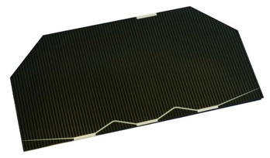

Space Grade Solar Panels
Conventional solarcells usedfor civilianapplicationstypically
utilize a double-junction design. In contrast, triple-junction solar cells, preferred in space missions, prioritize heightened efﬁciency over concerns of cost and weight.
Engineered to effectively capture a wide spectrum of solar radiation, these cells excel in the challenging conditions of space with limited sunlight. Triple-junction cells signiﬁcantly enhance energy absorption and power generation.
Their durability in harsh space environments, including exposure to radiation and extreme temperatures, positions them as an optimal choice for powering satellites, space probes, and scientiﬁc instruments.

Slide 8
Space Grade Solar Panels
Ifwe consider adouble row of solar cells oneachface of a CubeSat, the number of
cells may be distributed as follows:
●
1U CubeSat: A 1U CubeSat with a double row of solar cells might have around 6 to 12 solar cells.
2U CubeSat: For a 2U CubeSat, a double row could result in approximately 12 to 24 solar cells.
3U CubeSat: A double row on a 3U CubeSat might feature around 18 to 36 solar cells.
6U CubeSat: On a 6U CubeSat, a double row conﬁguration could include approximately 36 to 60 solar cells.
12U CubeSat: For a 12U CubeSat, with a double row, you might ﬁnd around 60 to 120 solar cells (doployables).
●
●
●
●

Slide 10
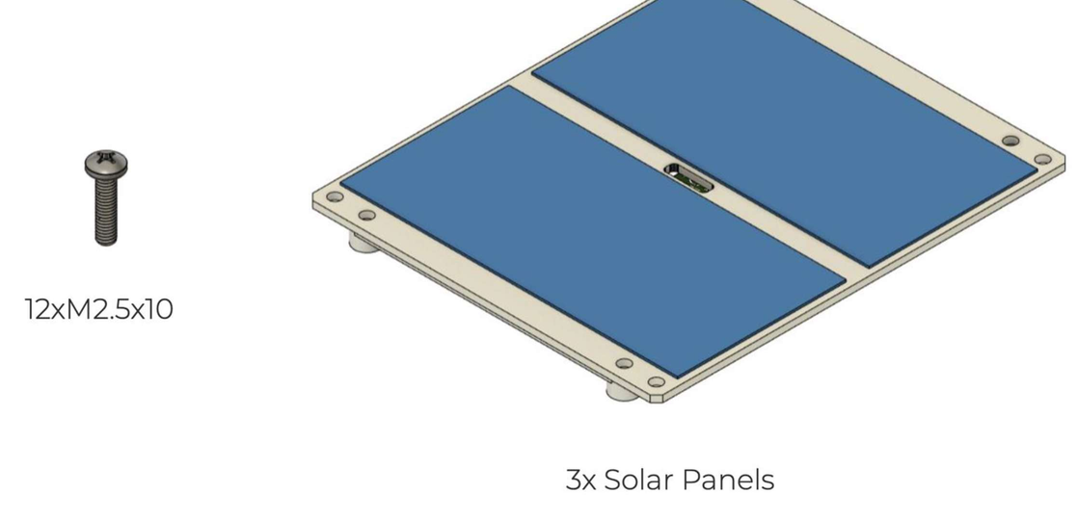
Satellite Set-up -Solar Panels

Slide 11

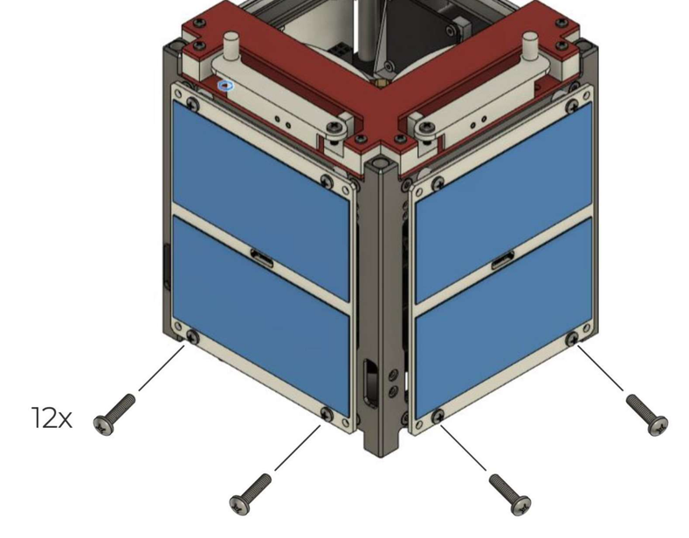
Satellite Set-up -Solar Panels
Before placing the solar panels we
need to:
Connect the solar cells outputs to the EPS. Connect the sun sensors to the ADCS.
Refer to the EPS and ADCS schematics to understand where to connect each cable.
Use the spacers behind the panels to place them on the satellite.

Slide 12
Reading the EPS temperature
Now, referring to the OBC schematics, locate the connection of the EPS temperature sensor on the OBC (no need to send it via LoRa). Write a code to read the temperature of the EPS -the output in your serial monitor should look like: 'TEMPEPS = 20.6.' The EPS utilizes the same temperature sensor as the OBC (LM35).
provides the desired information when asked. Remember to create separate functions for each. (Optional)
Utilize the serial plotter to graphically represent all readings, including TEMPOBC, TEMPEPS, and VBAT.
Remember that the reading must be continuous to correctly plot the values. Find a way to calculate the variability of the sensor readings within a 5 seconds as sample time.

Slide 13
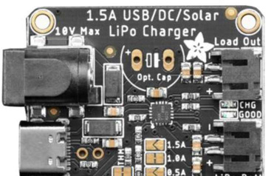

Reading the battery voltage
Refer to the OBC schematics to determine how to read the battery voltage (VBAT) using the Adafruit 4755 solar charger. Consult the datasheet online for accurate calculations of the battery voltage. Enable it to be called via serial by typing 'VBAT'.

Slide 14
Let's integrate warnings in to the satellite!
While a satellite remains unmodiﬁable once launched, it can still be operated to some extent by a ground station.
In addition to ADCS control and operative modes, we can leverage sensor data to monitor the behavior of subsystems.
If the battery level is too low or the temperature is excessively high, we can deactivate certain systems. These decisions are typically made autonomously upon receiving a warning.

Slide 15
Warnings arefunctions thatneed to run in the background, constantly monitoring speciﬁc conditions. Even if the satellite's status is not actively queried (from the serial monitor), these warnings should appear when such conditions undergo a change.
●
Create a warning function that checks the temperatures of both the OBC and the EPS. If either of them detects a temperature higher than 30 degrees Celsius, display the following message in your serial monitor:
[3m 43s] WARNING! TEMPOBC is too high: 35 deg! [3m 43s] WARNING! TEMPEPS is too high: 35 deg!
or
We can use the rework to test it out!

Slide 16
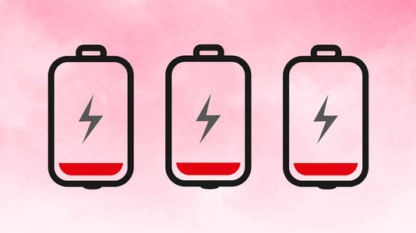
●
Create a warning function that checks the voltage of the battery on the EPS. If the value is found to be lower than 3.6 V, display the following message in your serial monitor:
[3m 43s] WARNING! VBAT is too low: 3.5 V!

Slide 17
Addtothe codethepossibility of typing “STATUS” to get an output that looks like this:
● ● ●
[3m 43s] NOMINAL
[3m 43s] WARNING! TEMPxx is too high: 35 deg!
[3m 43s] WARNING! VBAT is too low: 3.5 V!
if no warnings are found
if temperature is too high
if battery is too low

